Slide 1

Grover’s Algorithm for AI: A Quantum Approach to Unstructured Search
Asif Alif
EECS
Date: September 1, 2026
Mountain West AI & HPC Summit

Slide 2
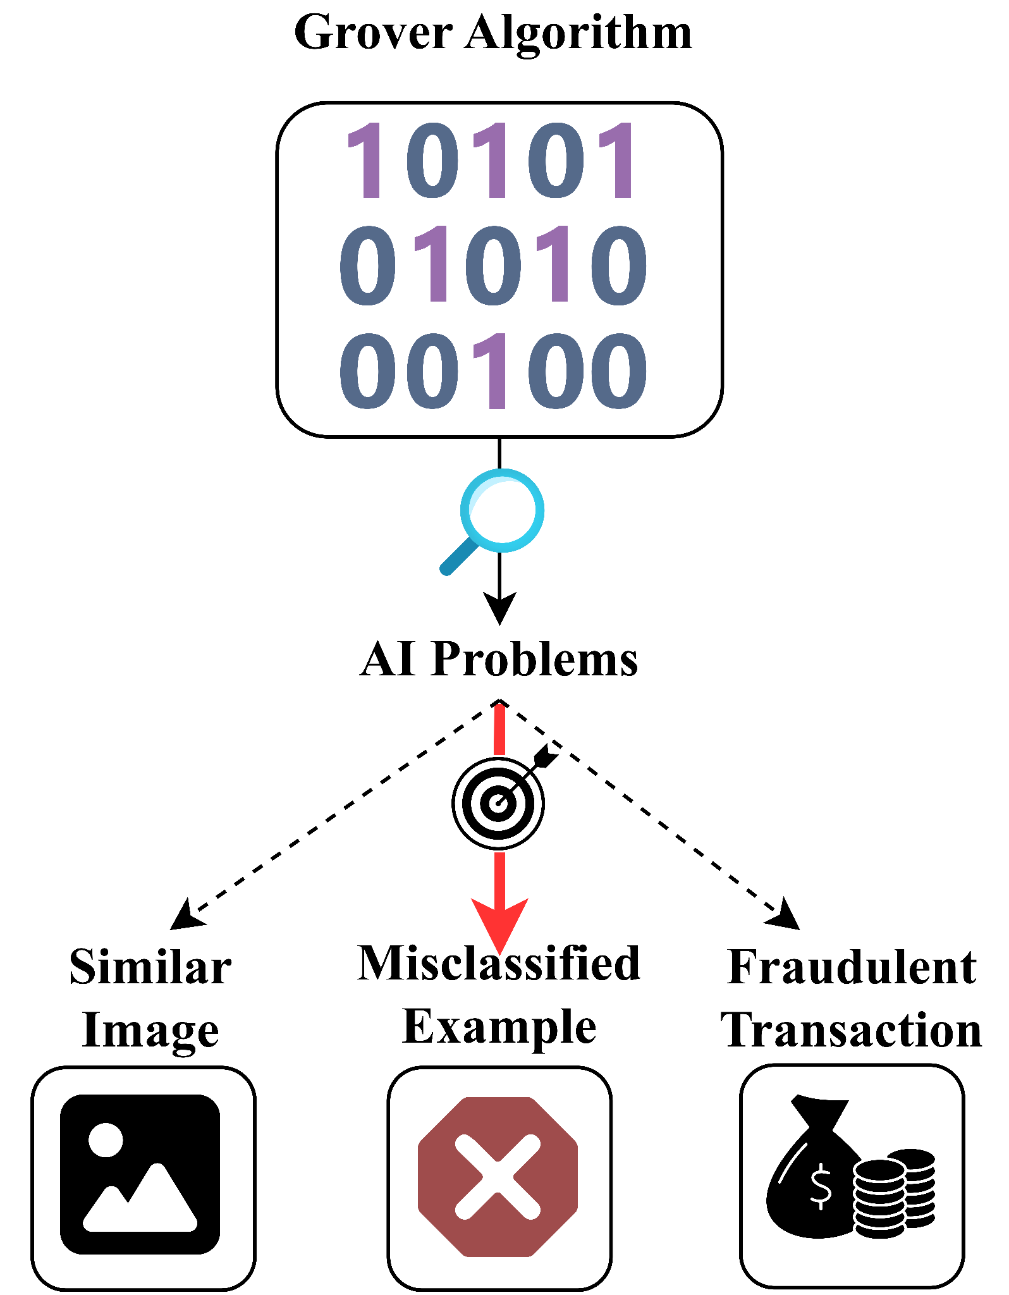
What AI Problem Are We Tackling and Why Grover?
Some AI tasks require searching through many examples when the desired example is not known in advance.
For example:
Finding a misclassified example.
Finding a similar image.
Finding a fraudulent transaction.
Focus of this talk: Finding a misclassified example.
Grover’s algorithm is designed for unstructured search.
For N examples, finding a misclassified example using unstructured search requires:
Classical search: O(N) queries.
Grover search: O(√N) queries.
L. K. Grover, “A fast quantum mechanical algorithm for database search,” in Proceedings of the twenty-eighth annual ACM symposium on Theory of computing, 1996, pp. 212–219.

Slide 3
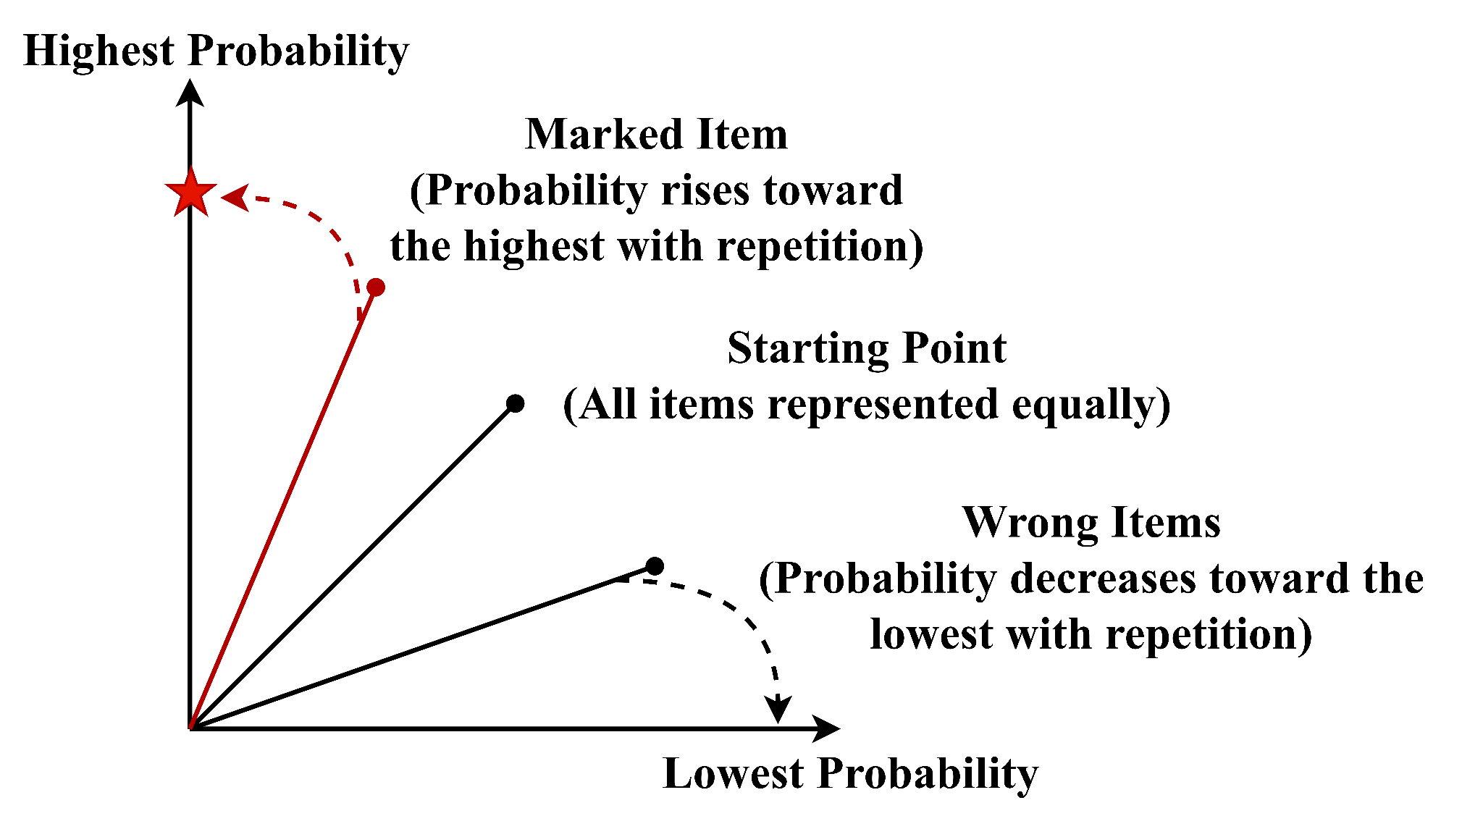
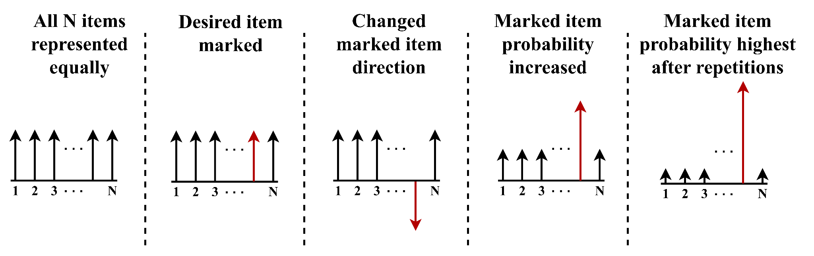
How Grover’s Algorithm Works
Perform an unstructured search over N items.
Apply a special quantum operation to represent all items equally.
Use a quantum checking function to mark the desired item.
Use another quantum operation to increase the probability of selecting the marked item.
Repeat the marking and probability increasing steps O(√N) times.
Measure to obtain the desired item with high probability.
L. K. Grover, “A fast quantum mechanical algorithm for database search,” in Proceedings of the twenty-eighth annual ACM symposium on Theory of computing, 1996, pp. 212–219.

Slide 4
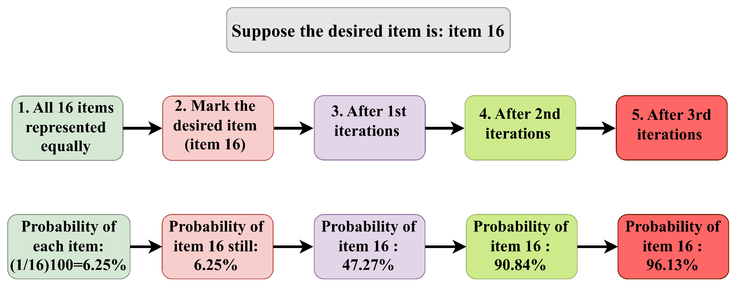
Grover Search Example: N=16

Slide 5
Grover Algorithm for AI: Finding Misclassified Examples
Perform an unstructured search over N labeled examples.
A classifier predicts a label for each example.
Compare the predicted label with the known true label.
A misclassified example satisfies: Predicted Label ≠ True Label.
Use this condition to mark a misclassified example during Grover search.
Measure to identify the misclassified example with high probability.
Reuse the identified example during training to help improve the classifier.

Slide 6
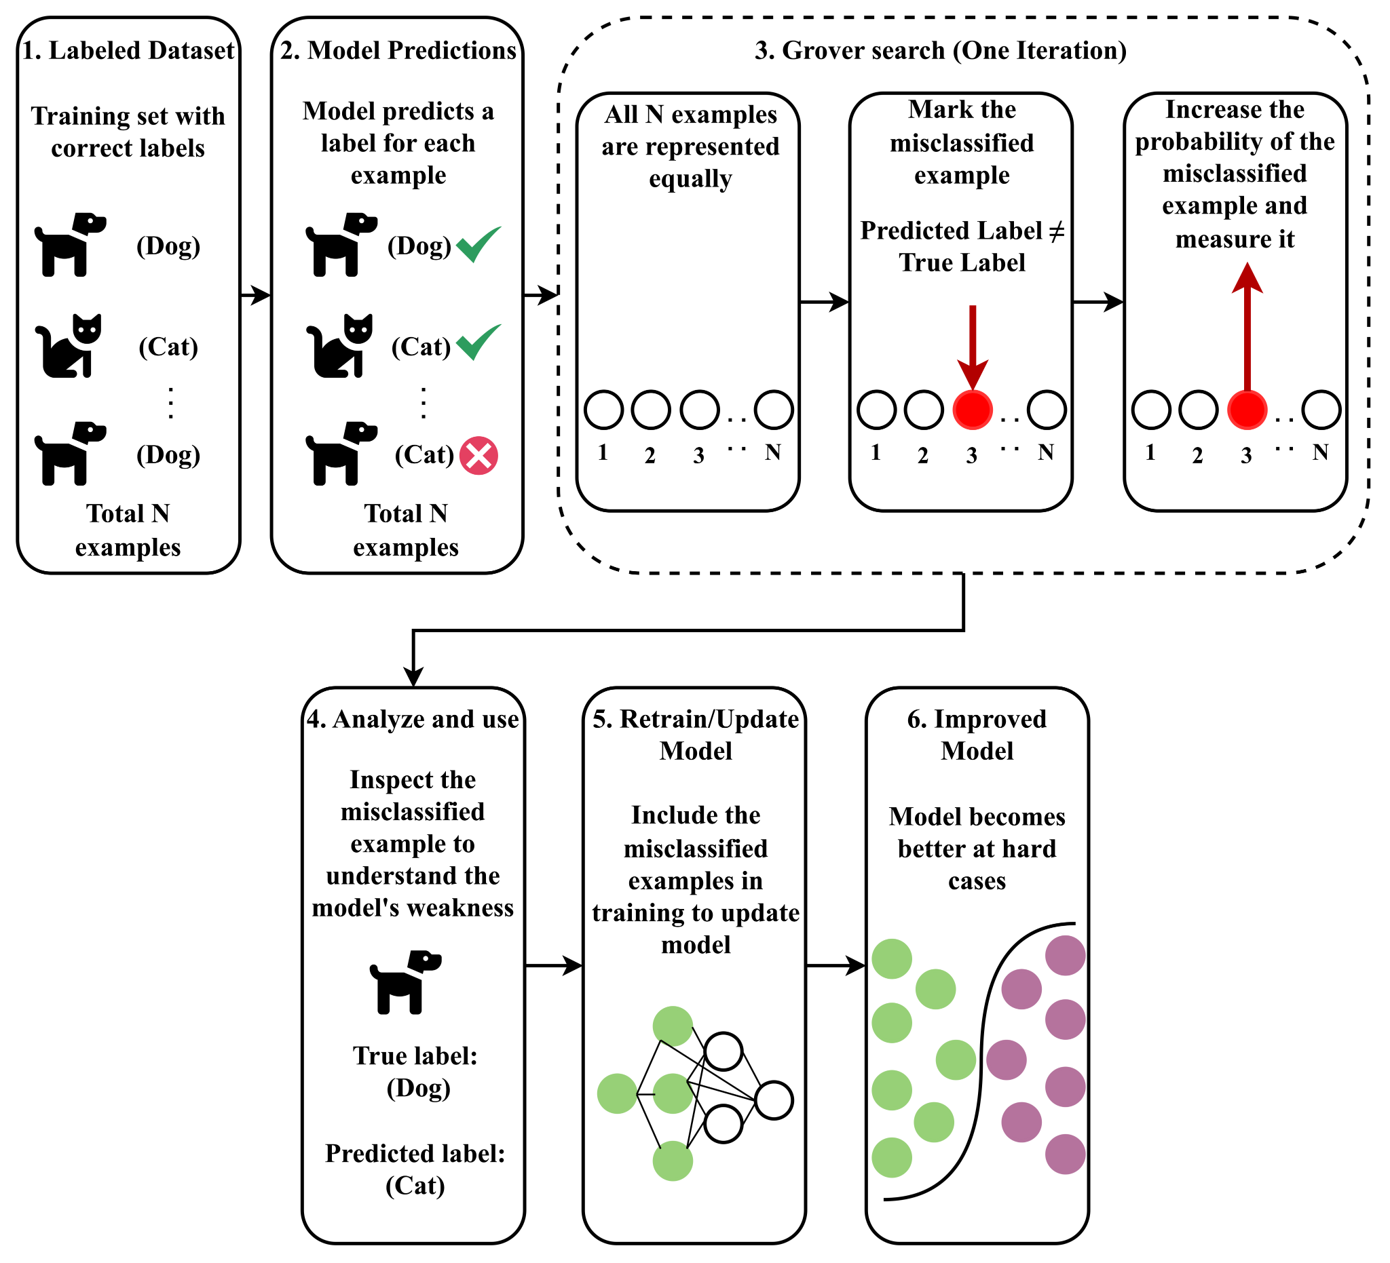
Grover-Assisted AI: Working Flow Diagram

Slide 7

Limitations
Requires a quantum computer to run Grover’s algorithm.
Requires an efficient quantum checking function for the search condition.
O(√N) represents query complexity, not total runtime; actual runtime depends on the cost of the required quantum operations and may not always be faster than classical search.

Slide 8


Slide 9
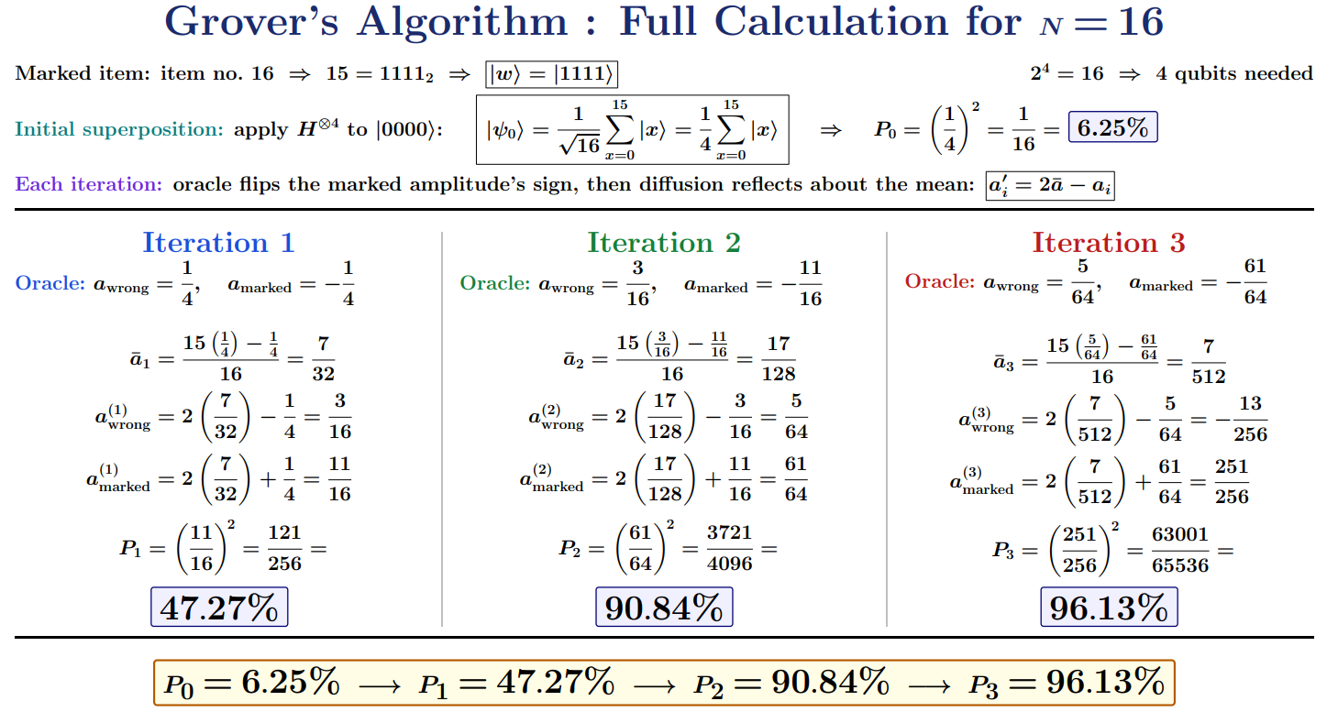
Full Calculation of Grover’s Algorithm for N=16
L. K. Grover, “A fast quantum mechanical algorithm for database search,” in Proceedings of the twenty-eighth annual ACM symposium on Theory of computing, 1996, pp. 212–219.

